Slide 1


Slide 2

INTRODUCTION
SUCHITRA CHAKMA
ASSISTANT TEACHER
TINTILA MODEL GOVT. PRIMARY SCHOOL
U.P- LONGADU
DISTRICT-RANGAMATI HILL TRACTS

Slide 3
ENGLISH FOR TODAY
Class: Five
Time: 50 minutes

Slide 4
WARM UP ACTIVITY BY VEDIO CLIP

Slide 5
Today’s Lesson:
Lesson:- 7(Eat healthy Live Healthy)
Lesson name:- B ( Read the text ……keep healthy )
Page no :- 35

Slide 6
To know about whice food they should eat more to keep healthy.
To learn some words meaning (Fresh, Moderately ,Attention , Healthy, Bottom etc.)
To write correct answer
Learning outcomes
Students will be able

Slide 7
INPUT
Time-15 minutes

Slide 8
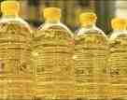
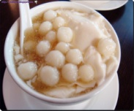
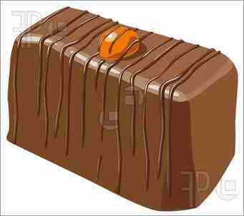

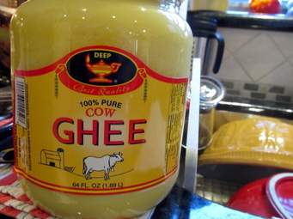
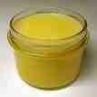
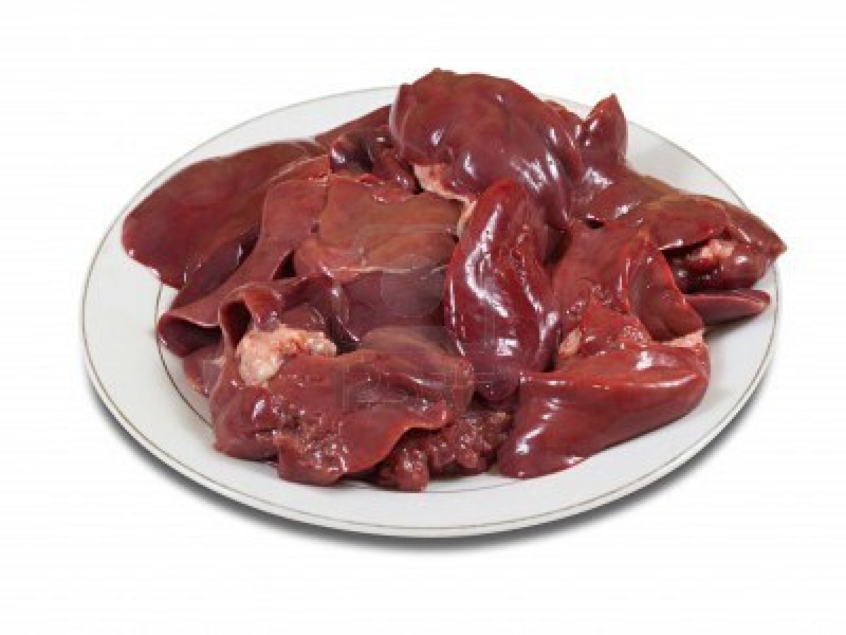
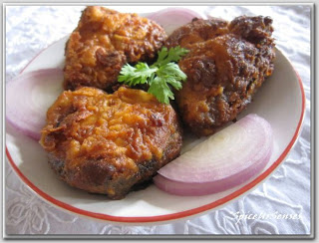

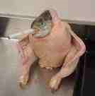
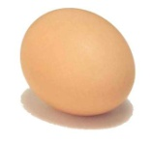
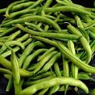
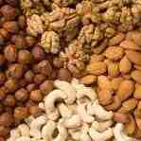
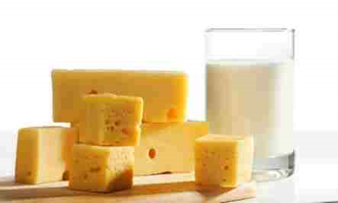
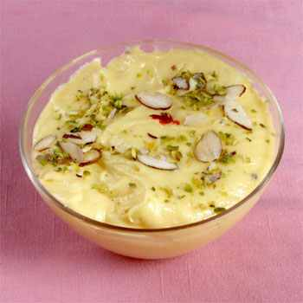
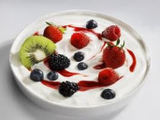
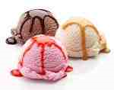
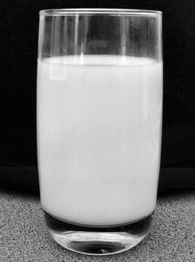
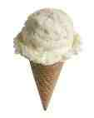
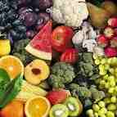



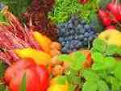
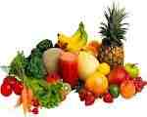
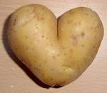
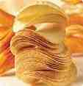
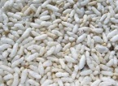

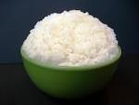
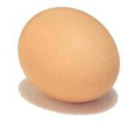

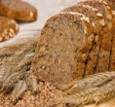


FOOD PYRAMID
Look, listen and say.
5
4
3
2
1

Slide 9



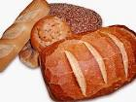
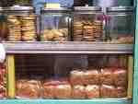
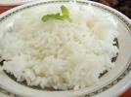
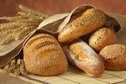
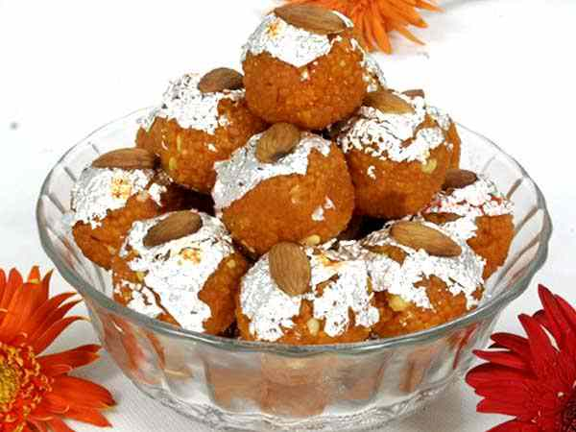
Sawing the chart & discussion by the picture
The bottom of the Food Pyramid
Chapati
Chapati
Muri
eggs
noodles
cereals
potato
bread
biscuits
rice
cereals
Chapati

Slide 10
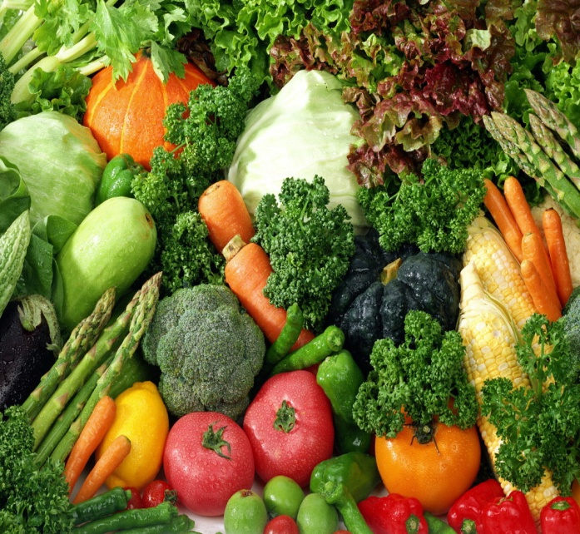
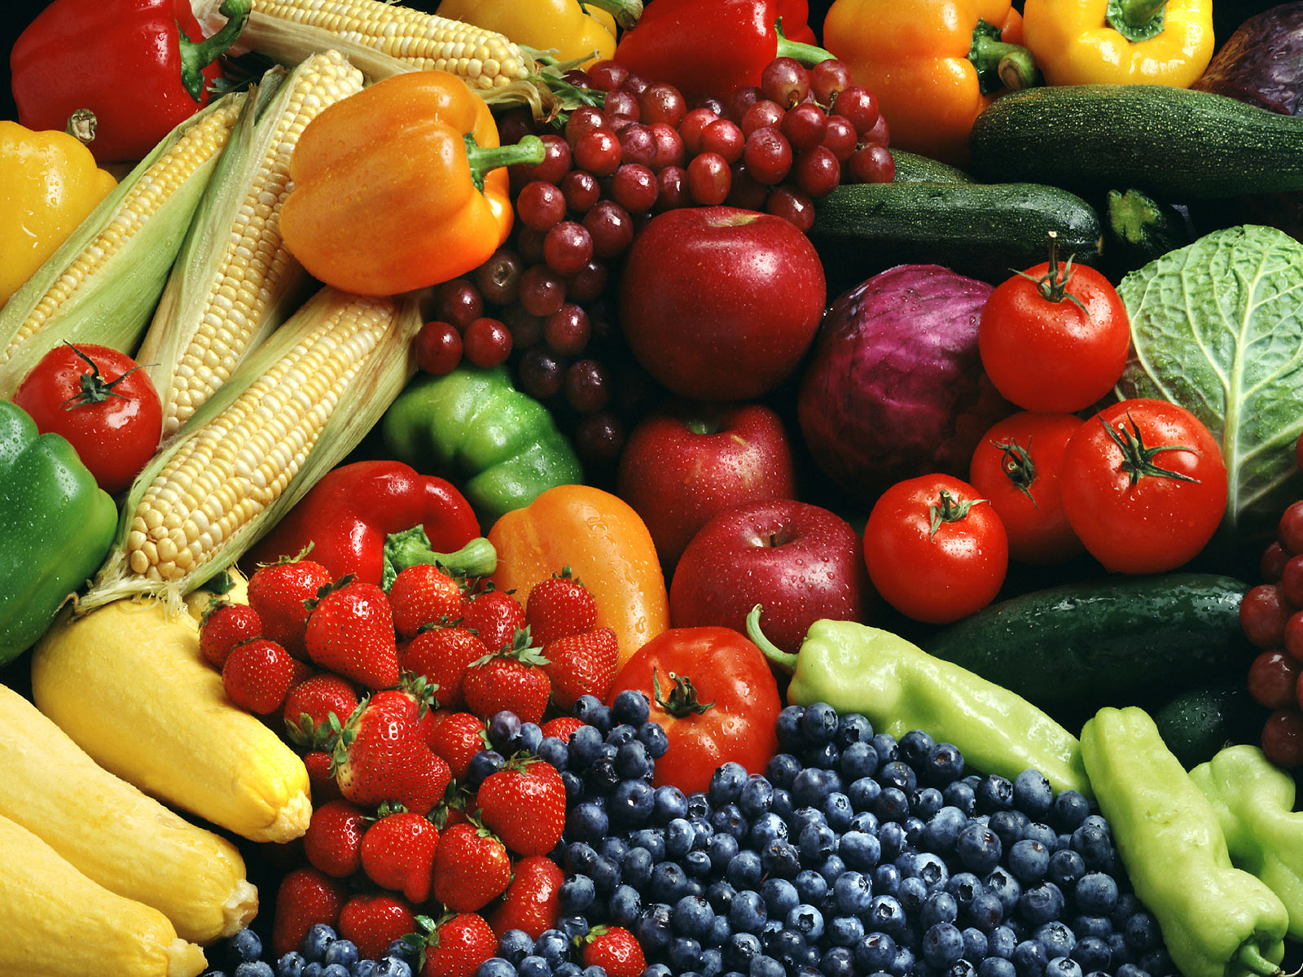
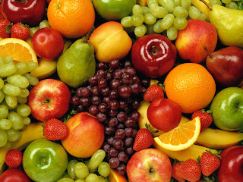
Sawing the chart & discussion by the picture
Foods Pyramid/Food Chart-(base- 2)
Different types of vegetable & fruits

Slide 11
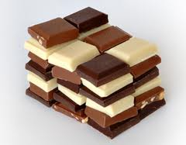
Sawing the chart & discussion by the picture
Base-3
Yogurt
Ice-cream
Base 3 in the food pyramid
cheese
milk
chocolate

Slide 12
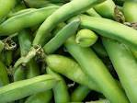

BASE -4 of the Food Pyramid
meat
nuts
eggs
fish
bean

Slide 13
sweets
oil
Top level
sweets
ghee
Sawing the chart & discussion by the picture
ghee
chocolate

Slide 14
PRACTICETime-30 minuets

Slide 15
Open your book,listening the text you read aloud the topics from your textbook.
Time-5 minutes

Slide 16
Look, listen and say.
a) What does your body need?
five groups of food
Good mix of food
A huge pile of foods
The food Pyramid
b)Which foods are good?
Measured goods
Measured good foods
A huge pile of foods
Some fresh fruits and vegetables
c)How will you be healthy?
By eating good foods
by eating healthy foods
By eating a huge pile of foods
By eating some fatty foods
d) What is the most important meal of the day?
Diner ii) Lunch iii) Breakfast iv) Snack

Slide 17
e) What is the food pyramid ?
The five groups of foods
a huge pile of foods in Egypt
A good mix of foods
Some costly foods
f) How will you feel after eating a healthy breakfast ?
Strong and active
Easy
Worried
unhappy
g) Which foods should we take very little ?
Fats, oils and sweets
Milk, cheese meat
Beans, nuts and eggs
Breads, cereals and rice

Slide 18
h)What should we eat regularly ?
Meat and fish
Fats and oils
Milk and eggs
Fresh fruits and vegetables
i) You should eat these foods moderately . Make Wh –question for the above sentence.
What foods should we eat moderately ?
Which foods should we eat moderately ?
How many foods should we eat food moderately ?
How much foods should we eat food moderately ?
j) Your body needs a good mix of foods. The above sentence is -----
Assertive ii) imperative iii) interrogative iv) optative

Slide 19
Match the word of column A with their meaning that is mentioned in the text in the column B(there is two extra).
A
B
To listen carefully
The lowest part of something
Good for your health
The upper part of something
Recently produced or picked and not frozen
Something that is rotten
To an average extent
Fresh
Moderately
c) Attention
d) Healthy
e) Bottom

Slide 20
Match the word of column A with their meaning that is mentioned in the text in the column B(there is two extra).
A
B
To listen carefully
The lowest part of something
Good for your health
The upper part of something
Recently produced or picked and not frozen
Something that is rotten
To an average extent
Fresh
Moderately
c) Attention
d) Healthy
e) Bottom

Slide 21
Group work
Write the answer of the following questions
1
Which foods are important for health?
Grup-1
2
Write three sentence about food Pyramid?
Grup-2
3
What foods do you see at the base , or the bottom of Pyramid?
Grup-3

Slide 22
TASK
Time : 5 minutes

Slide 23
Bingo Game
Writs these words
Pyramid, cereals, plenty, moderately, sweets , biscuits, breads ,chapati, chocolates , milk , cheese, fish ,ice-cream

Slide 24
Bingo Game
Cut s these words
Pyramid, cereals, plenty, moderately, sweets , biscuits, breads ,chapati, chocolates , milk , cheese, fish ,ice-cream

Slide 25
BINGO

Slide 26
Learning assessment
Time -5 minutes
To see there note khata

Slide 27
Home work
Page no. 29 (B1)

Slide 28


